Slide 1







Microsoft PowerPoint

Slide 2


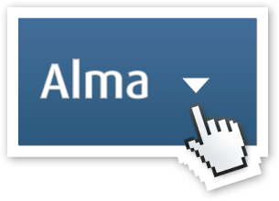

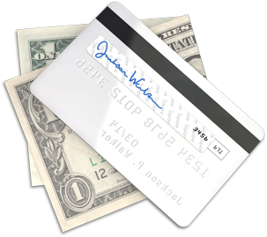

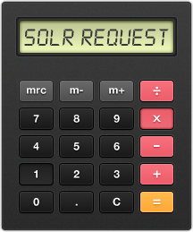

Microsoft PowerPoint

Slide 3

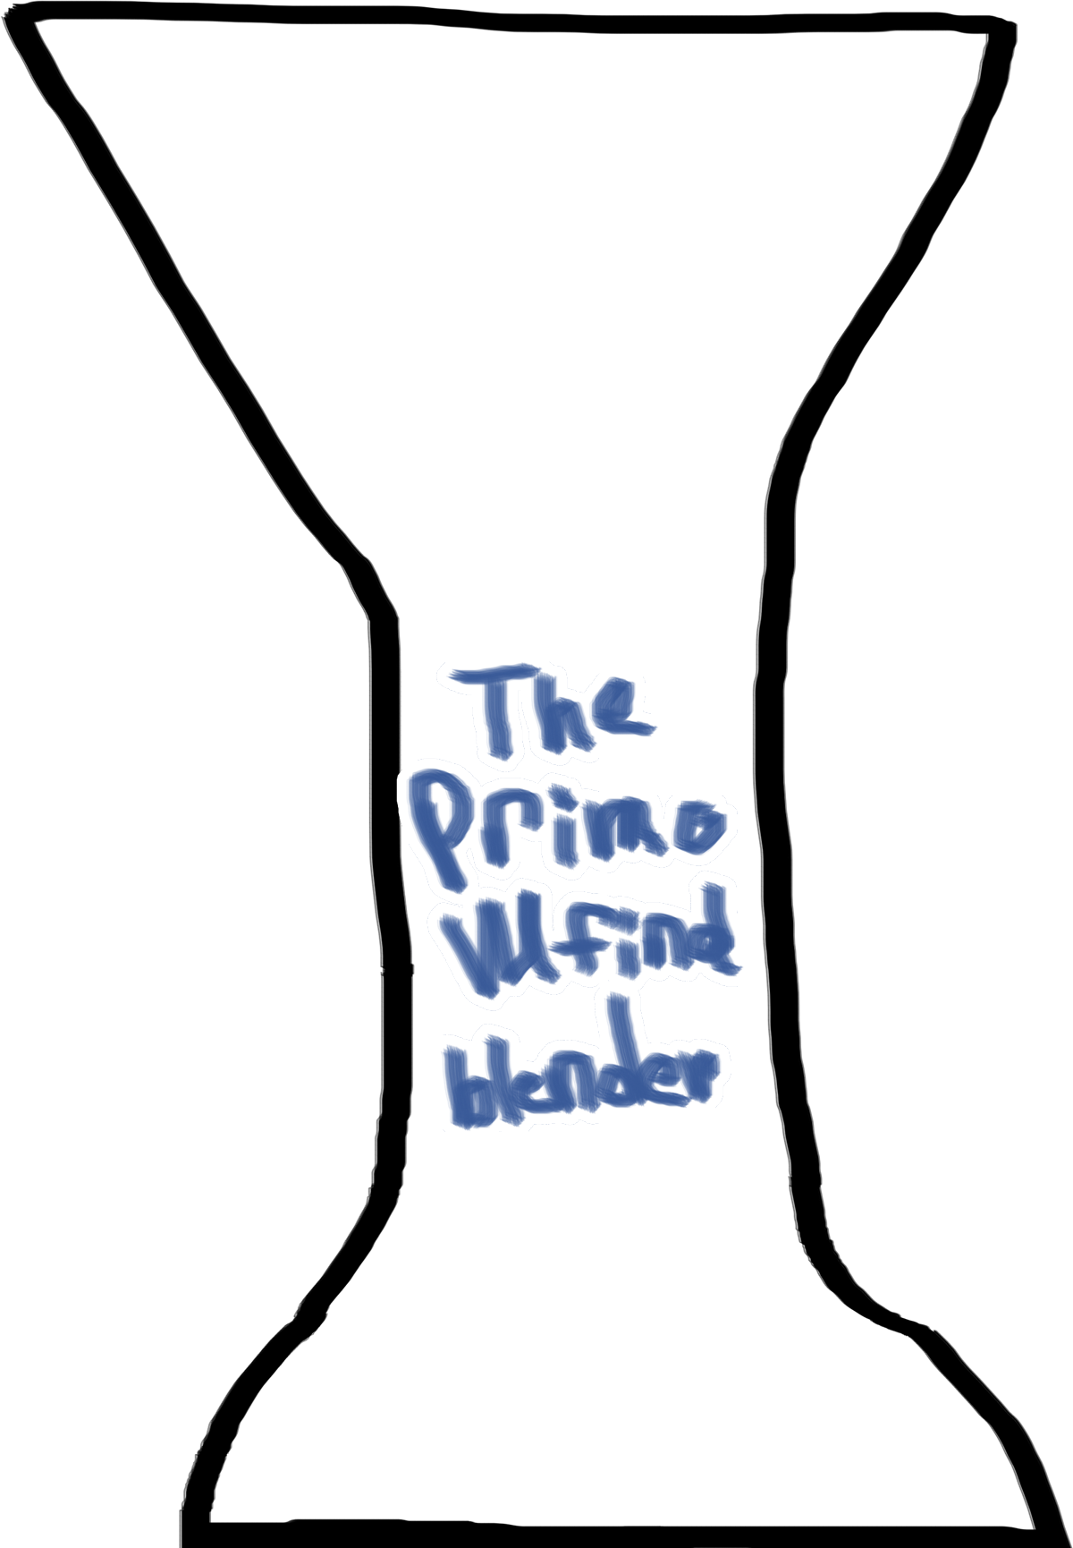





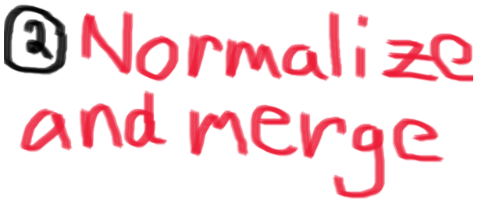
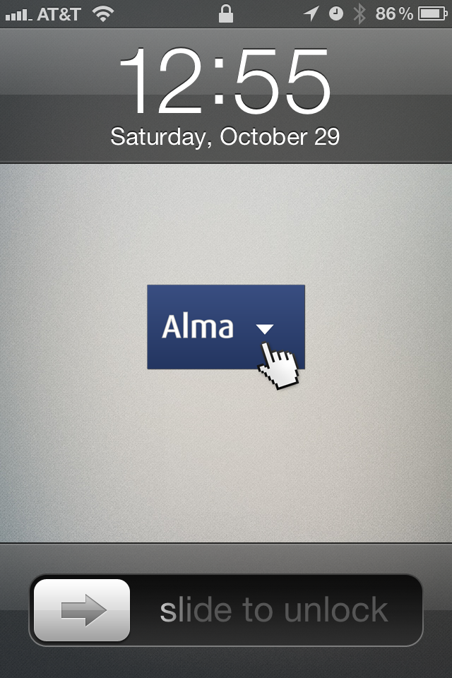

Slide 4

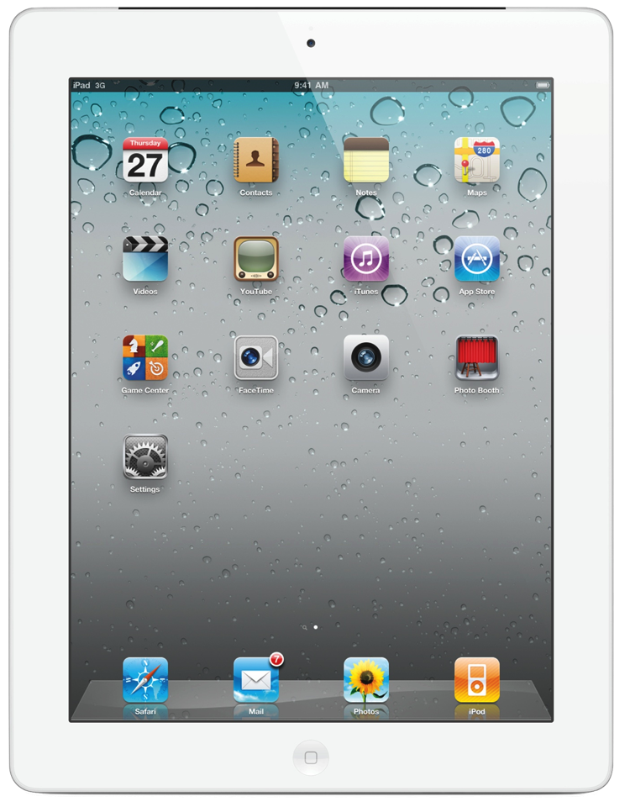
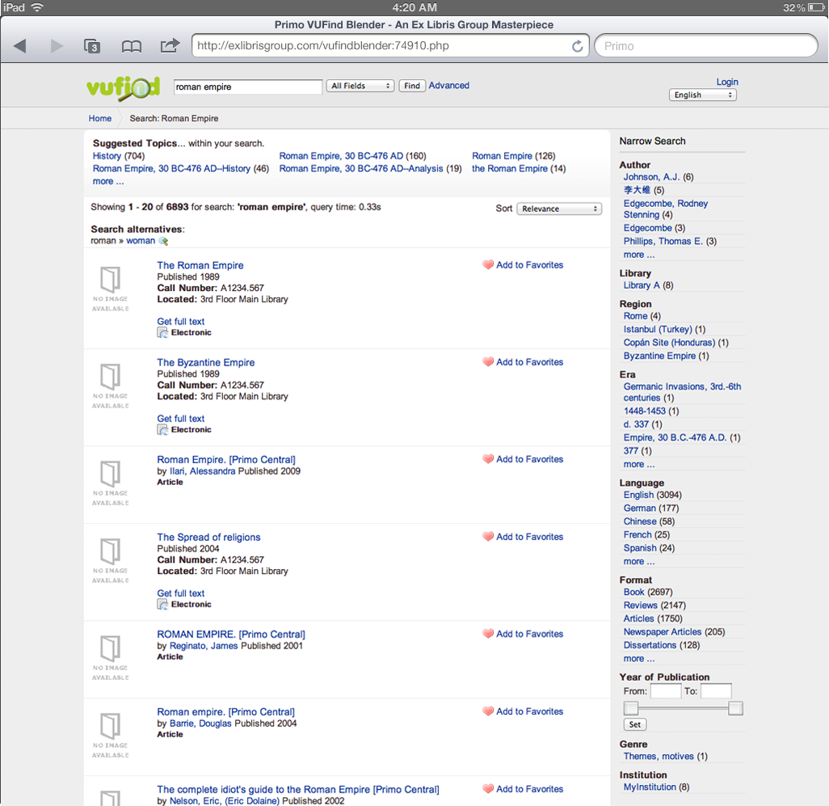
Notes:
Combining versus built from scratch
Community driven software
Agile Development/Mature product (Ex Libris has been doing “inventory control” since 1986.)

Slide 5
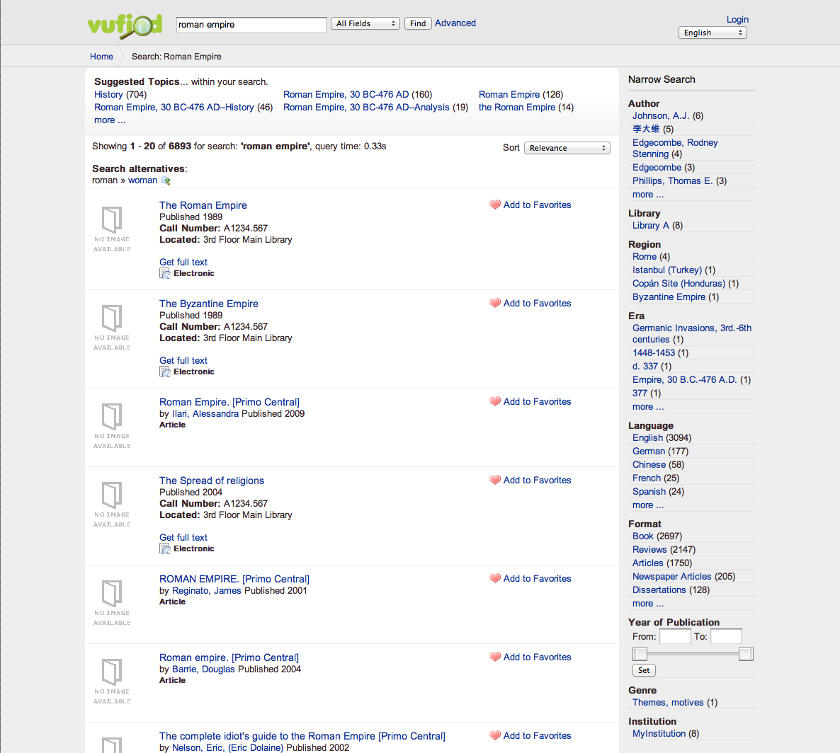
http://discoveralma.com
Notes:
Combining versus built from scratch
Community driven software
Agile Development/Mature product (Ex Libris has been doing “inventory control” since 1986.)

Slide 6

DiscoverAlma.com
http://discoveralma.com
Notes:
Combining versus built from scratch
Community driven software
Agile Development/Mature product (Ex Libris has been doing “inventory control” since 1986.)

